Slide 1

What makes you happy?

Slide 2
The analysis presented the available global data on national happiness and reviewed related evidence from the emerging science of happiness, showing that the quality of people’s lives can be coherently, reliably, and validly assessed by a variety of subjective well-being measure
Objective of the analysis

Slide 3
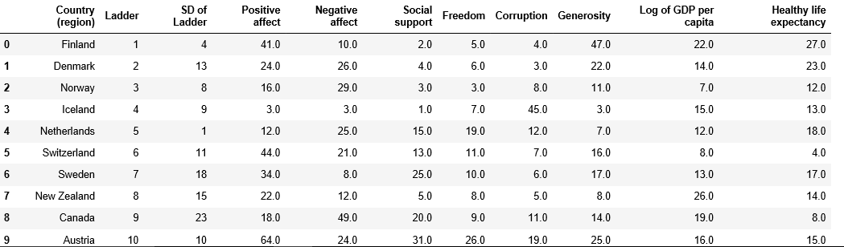
Sample view OF data frame of the report
For first ten happiest countries

Slide 4
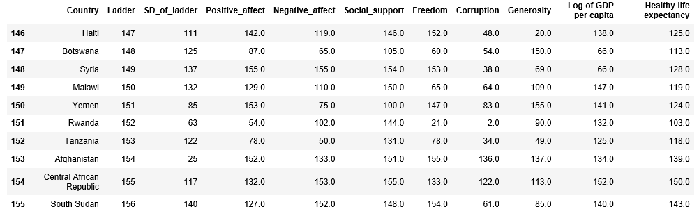
View for the last ten dataset in report

Slide 5
Meaning of features in column
Ladder: The English wording of the question is “please imagine a ladder, with steps numbered from 0 at the bottom to 10 at the top. the top of the ladder represents the best possible life for you and the bottom of the ladder represents the worst possible life for you. on which step of the ladder would you say you personally feel you stand at this time?” this measure is also referred to as cantril life ladder, or just life ladder in the data.
Positive aﬀect is deﬁned as the average of three positive aﬀect measures: happiness, laugh and enjoyment. These measures are the responses to the following three questions, respectively
Negative aﬀect is deﬁned as the average of three negative aﬀect measures. They are worry, sadness and anger, respectively the responses to “Did you experience the following feelings during A LOT OF THE DAY yesterday?
Social support (or having someone to count on in times of trouble) is the national average of the binary responses (either 0 or 1) to the question “If you were in trouble, do you have relatives or friends you can count on to help you whenever you need them, or not?”

Slide 6
Freedom to make life choices is the national average of responses to the question “Are you satisﬁed or dissatisﬁed with your freedom to choose what you do with your life?”
Corruption: The measure is the national average of the survey responses to two questions in the: “is corruption widespread throughout the government or not” and “is corruption widespread within businesses or not?” the overall perception is just the average of the two 0-or-1 responses.
Generosity is the residual of regressing national average of response to the GWP question “Have you donated money to a charity in the past month?” on GDP per capita.

Slide 7
Statistics and correlation of features
HEATMAP
Having a data set with many columns, a good way to quickly check correlations among columns is by visualizing the correlation matrix as a heatmap.

Slide 8
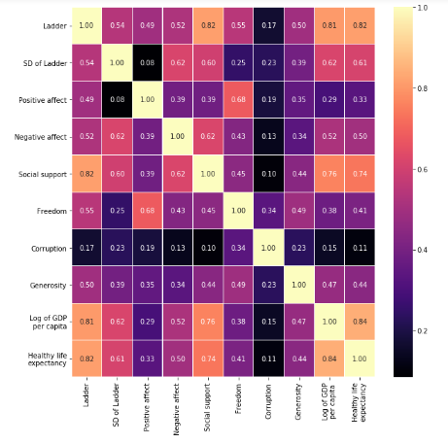

Slide 9
Deductions from heatmap
Log of GDP per capita == Healthy life Expectancy = 0.84
Healthy life Expectancy ==Ladder = 0.82
Social support == Ladder = 0.82
Log of GDP per capita == Ladder = 0.81

Slide 10
SCATTER PLOT/Seaborn
Scatter plot was used to show the relationship between each of the feature.
According to the analysis some of the features was compared with each other
Log of GDP per capita was compared with Healthy life expectancy to further explain its correlation
Position in Social support was compared with position in ladder
the positive affect and negative affect respectively to see how the position of the countries in positive affect and negative affect is related to their position in each of those features

Slide 11
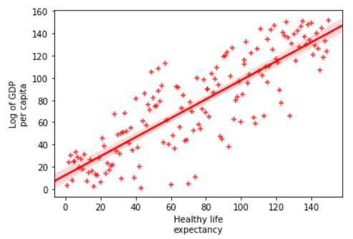
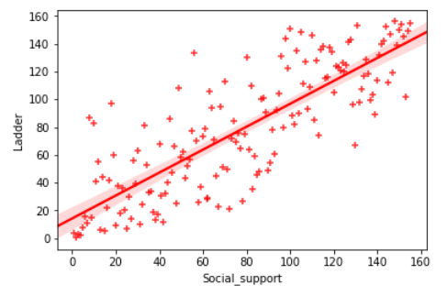
Graphical Plots of features

Slide 12
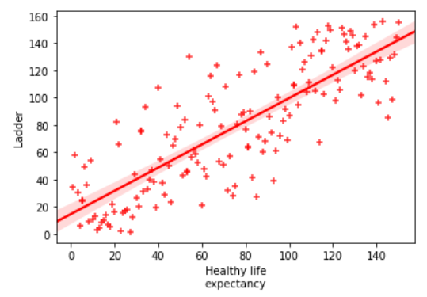
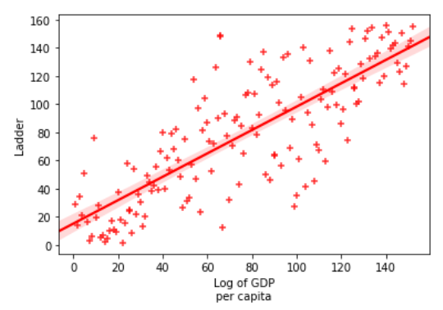
GRAPHICAL PLOTS OF FEATURES

Slide 13
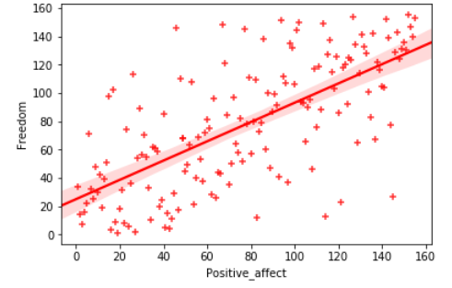
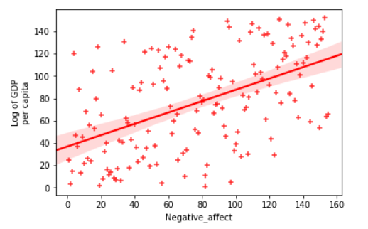
GRAPHICAL PLOTS OF FEATURES

Slide 14
CONCLUSION
The analysis, deductions can be make for factors that contributed to the position of countries on the happiness ladder.
Countries with high rank on the social support ladder also ranked high on the happiness ladder. It means that there is a strong correlation between Social support and how happy you are.
Log of GDP per capital correlates with healthy life expectancy
Log of GDP per capital correlates with the rank on centril ladder
High healthy life expectancy also highly determines happiness score and rank on ladder

